Slide 1

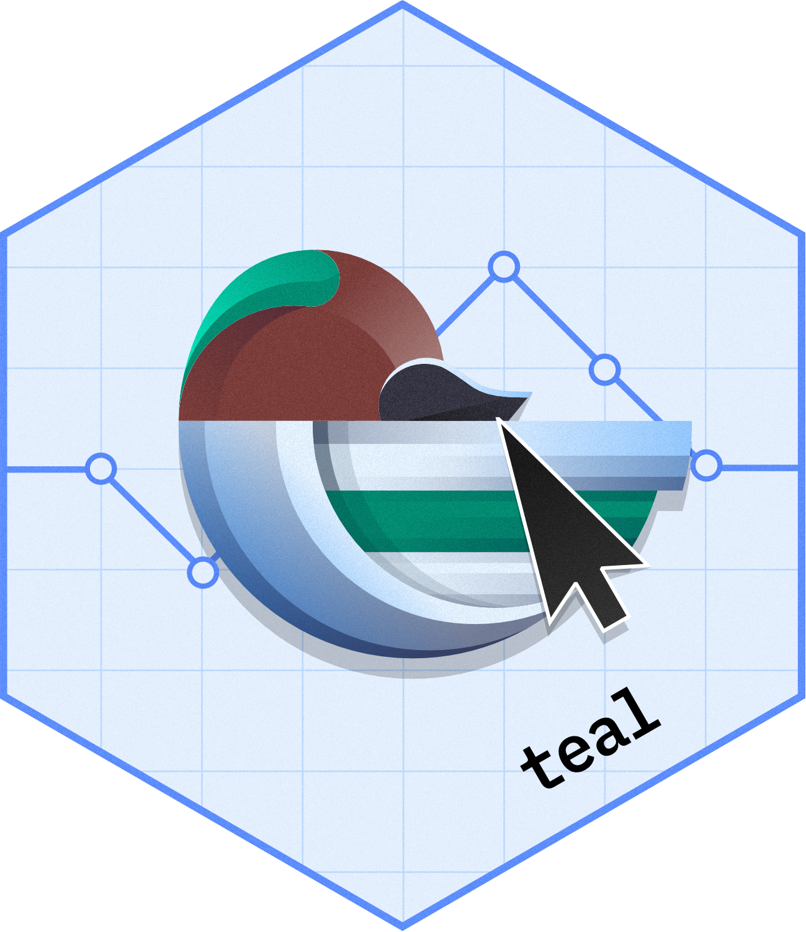
teal
An R-Shiny Framework to Unlock the Power of Interactive Data Exploration
Pawel Rucki
SEP 17, 2023 @ posit::conf(2023)

Slide 2
Agenda
Introduction to teal framework
Using teal as data scientist
Anatomy of teal and key features
Example app demo
teal-verse product map
Exercises

Slide 3
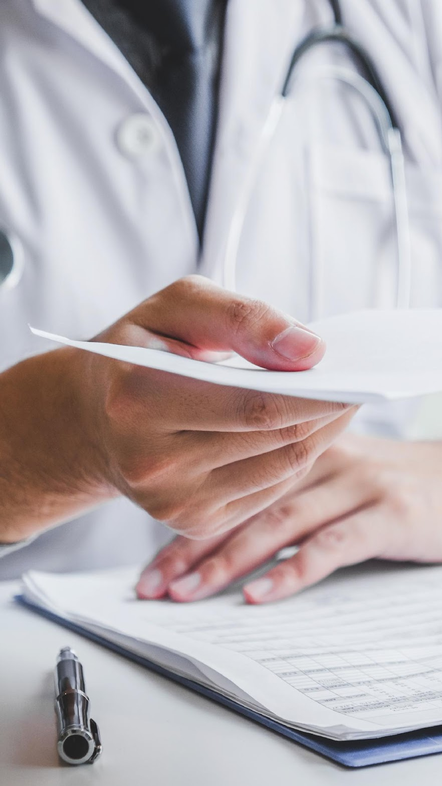

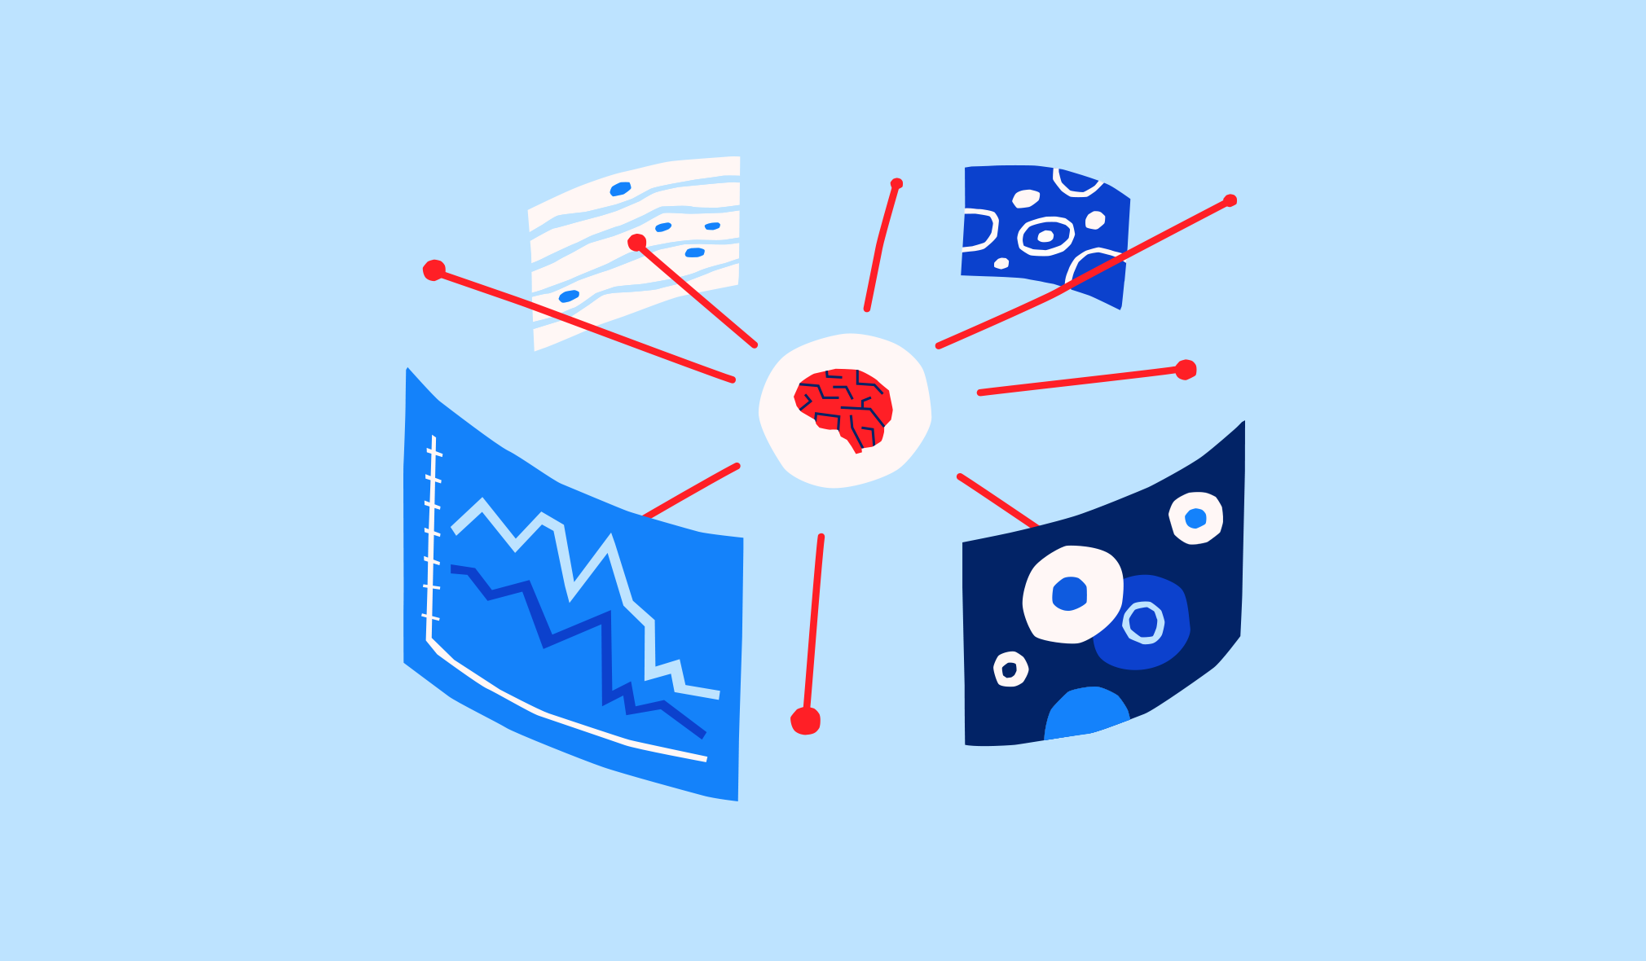
Product Development Data Sciences
Main task: reporting clinical trials
Summarising safety and efficacy data
Providing an accurate picture of trial outcomes
Managing data collection across international sites

Slide 4

Shifting to an open-source Data Science platform
01
Get latest developments more rapidly
Talent out of university more likely to know R
Open source offered opportunities:
02
Be able to switch between languages and contexts more easily
03
Collaboration with external partners

Slide 5
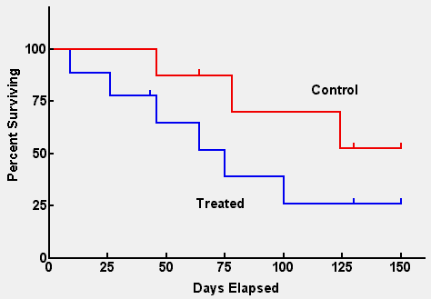
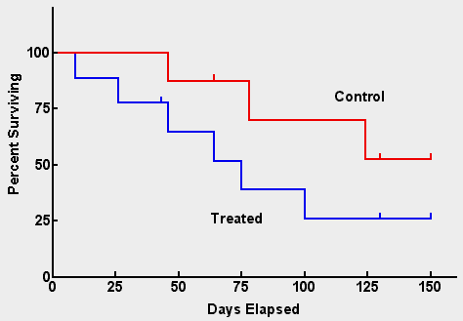
Improve efficiency in the way we work
Analyzing clinical trial data requires multiple ways of presenting and interacting with our data
Kaplan Meier Plot
Protocol: 1111 Snapshot: 222 Cutoff date: Jan 2, 2016
Per-SAP static output on OS
Additional Footnotes
Program:<path>/kmplot.R
Output: <path>/kmplot_ITT.pdf 1 of 3
Ad-hoc analysis on PFS
Ad-hoc analysis on PFS in subpopulation

Slide 6

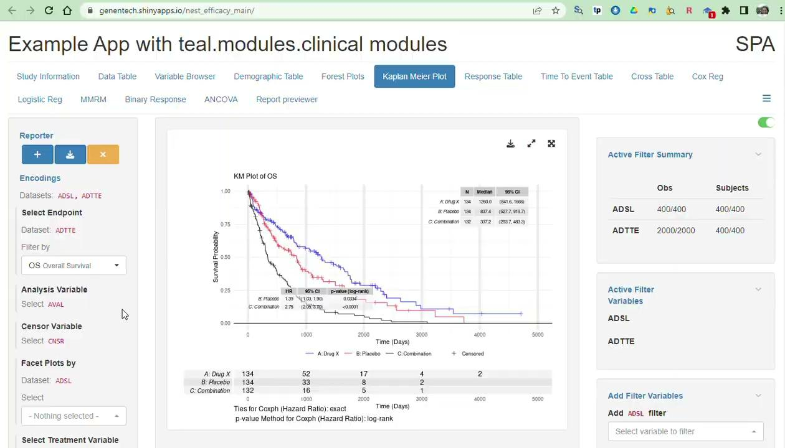
Improve efficiency in the way we work
Analyzing clinical trial data requires multiple ways of presenting and interacting with our data
Kaplan Meier Plot
Protocol: 1111 Snapshot: 222 Cutoff date: Jan 2, 2016
Per-SAP static output on OS
Additional Footnotes
Program:<path>/kmplot.R
Output: <path>/kmplot_ITT.pdf 1 of 3
Ad-hoc analysis on PFS
Ad-hoc analysis on PFS in subpopulation
Building scalable exploratory R-shiny web-apps

Slide 7
Building Scalable Exploratory Apps with {teal}
How to enable 600+ non-shiny developers to build exploratory apps for their clinical trials?
Build a framework centered around reusable modules that abstracts UI/server logic from the app developer

Slide 8

What is {teal}?
A RShiny-based interactive data exploration framework
Modularized and standardized building blocks
Collection of specialized R packages
Streamlines creation of web-apps that offers:
Dynamic filtering facility
Code reproducibility
Reporting engine
Many data summarization and visualizations

Slide 9

How does {teal} work?
Traditional shiny app
{teal} framework with modularized components
Data agnostic
Flexible
Cumulative
Collaborative
Crowdsourcing
Data
Dataset 1
Dataset 2
Dataset 3
Shiny
ui
server
{teal}
shiny app
Data
{teal} modules
{teal} framework
ui
server
Dataset 1
Module 1
ui
server
Module 2
ui
server
Module 3
ui
server
Dataset 2
Dataset 3

Slide 10
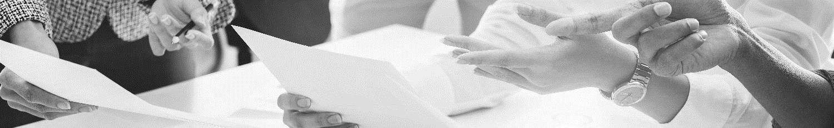
Application of {teal}
Clinical trial reporting
Outside of trial reporting setting
QCing of clinical trial reporting outputs
Trial monitoring
Ad-hoc & exploratory analyses
Content generation to support internal strategic decision meetings
Complement study milestone events
Pooled data analysis
Exploring high-dimensional biomarker
Exploring real-world data off-label use
Data quality monitoring
Operations analytics

Slide 11
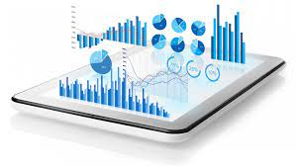


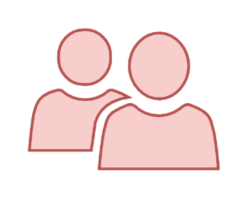
Using {teal} as a data scientist I
teal app
teal modules
teal App Developer
App User

Slide 12

Using {teal} as a data scientist II
teal app
teal module
teal module
teal module
teal modules
teal App Developer
teal Module Developer
App User

Slide 13
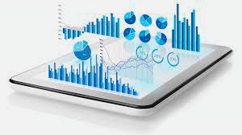
Using {teal} as a data scientist III
Study Team 1
Study Team 2
teal app
teal app
teal module
teal module
teal module
Study teal App Dev
Study teal Module Dev
Study App User
Study teal App Dev
Study teal Module Dev
Study App User
teal Module Developer

Slide 14

Demo Apps via teal Gallery
https://insightsengineering.github.io/teal.gallery/demo.html
Links on shinyapps.io
APP_NAME
Exploratory analysis on general data frames
“exploratory”
Safety analysis on clinical trial data
“safety”
Efficacy analysis on clinical trial data
“efficacy”

Slide 15
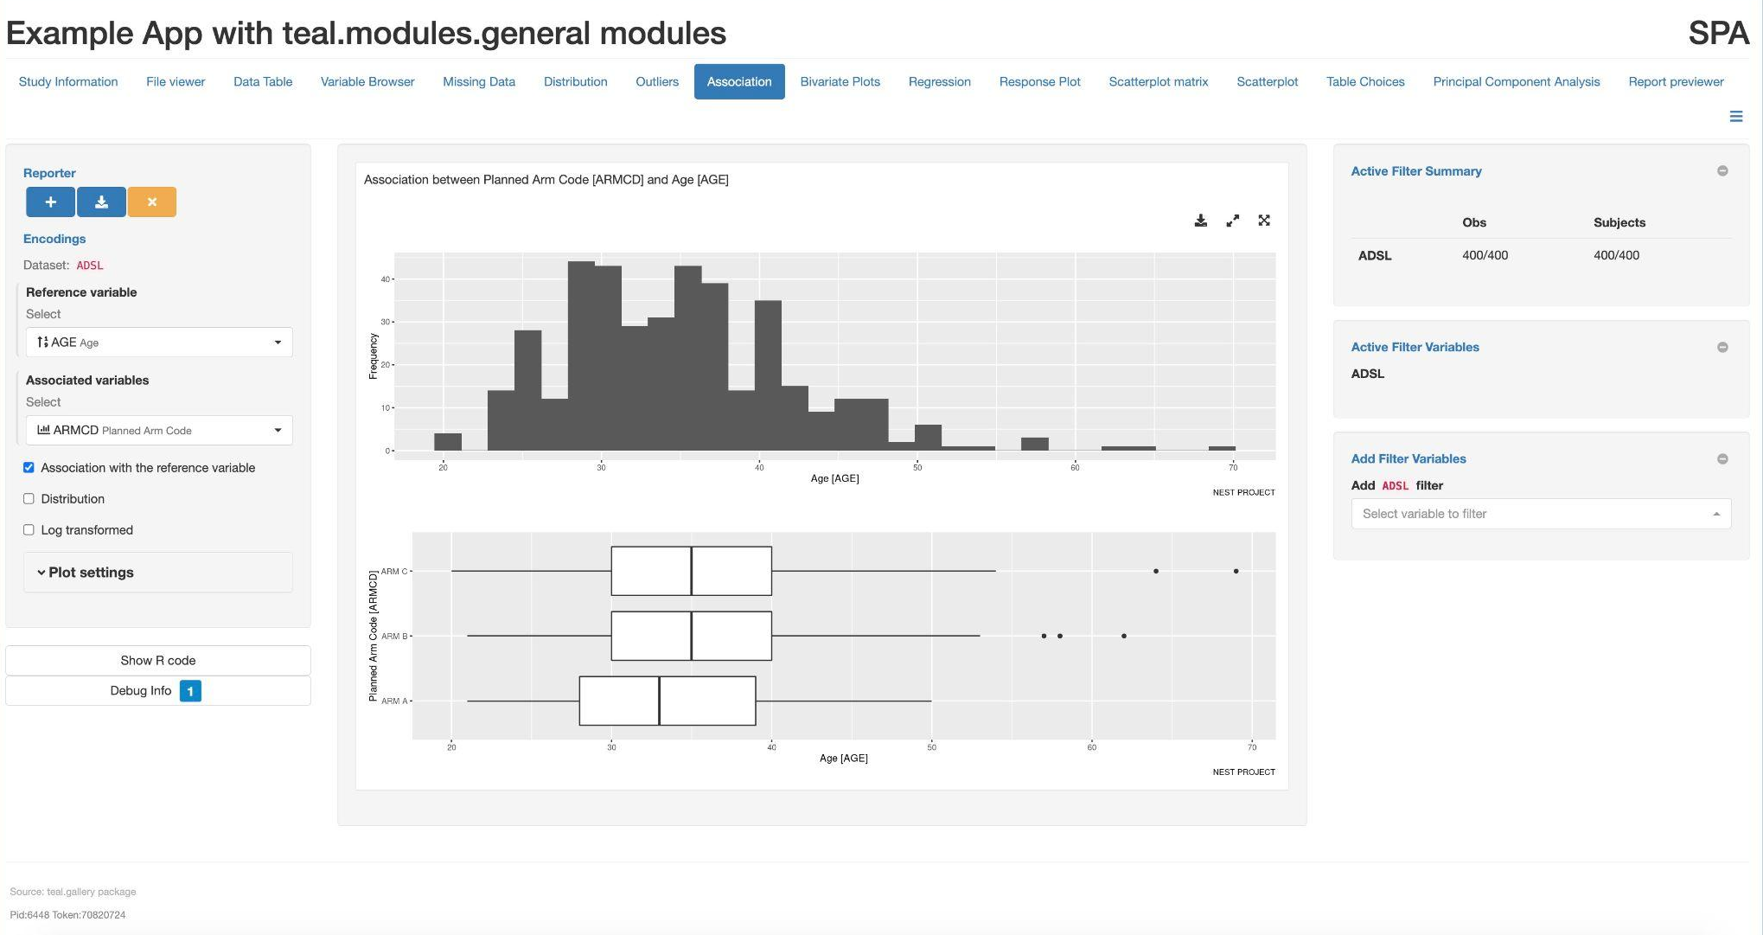
Header
Menu with tabs
Anatomy of a
teal app
Reporter
Output
* Toggle Filter Panel
Filter Panel
Encodings
* Download
* Better View
* Dimensions
Reproducibility
Debugging
Footer

Slide 16
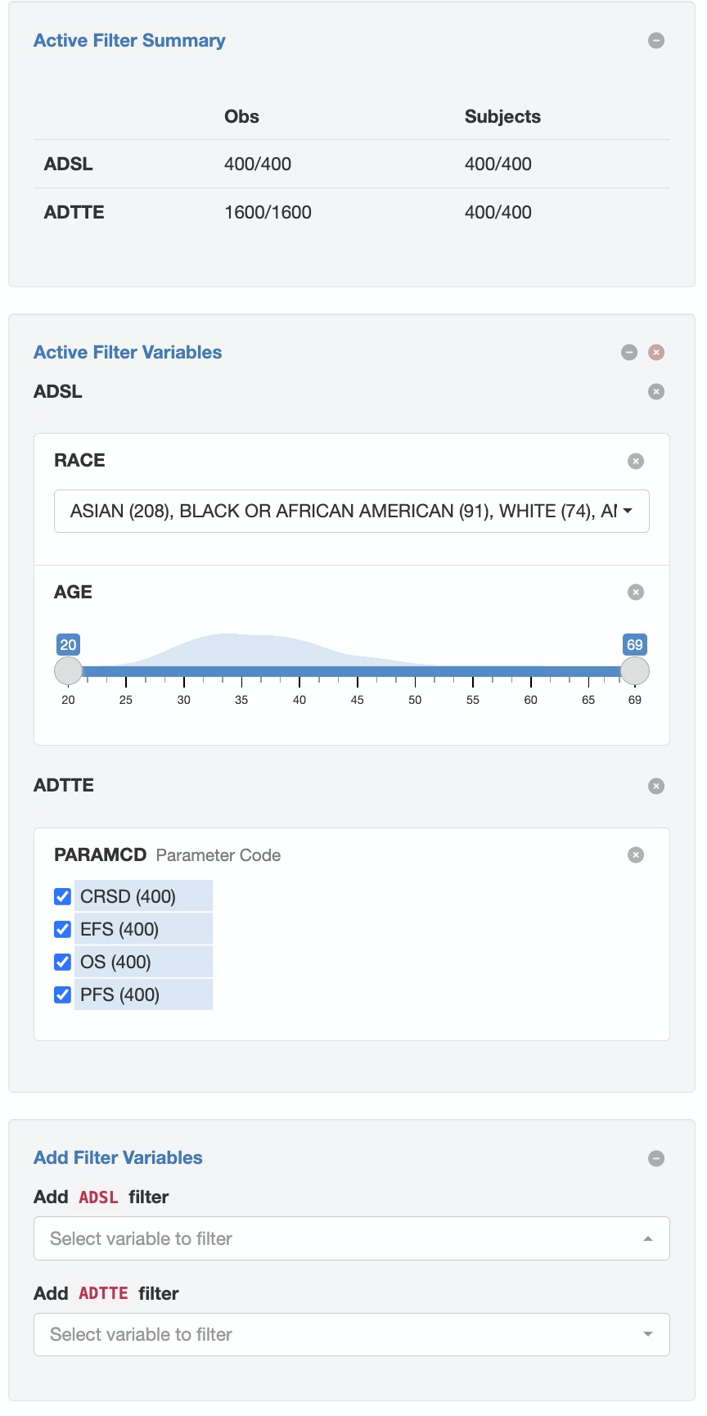

Key Features: Filter Panel
Ability to subset your dataset
Out of the box from teal framework
Active filter summary
Pre-defined filter state

Slide 17
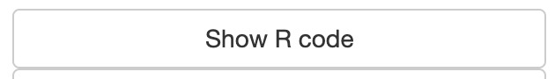
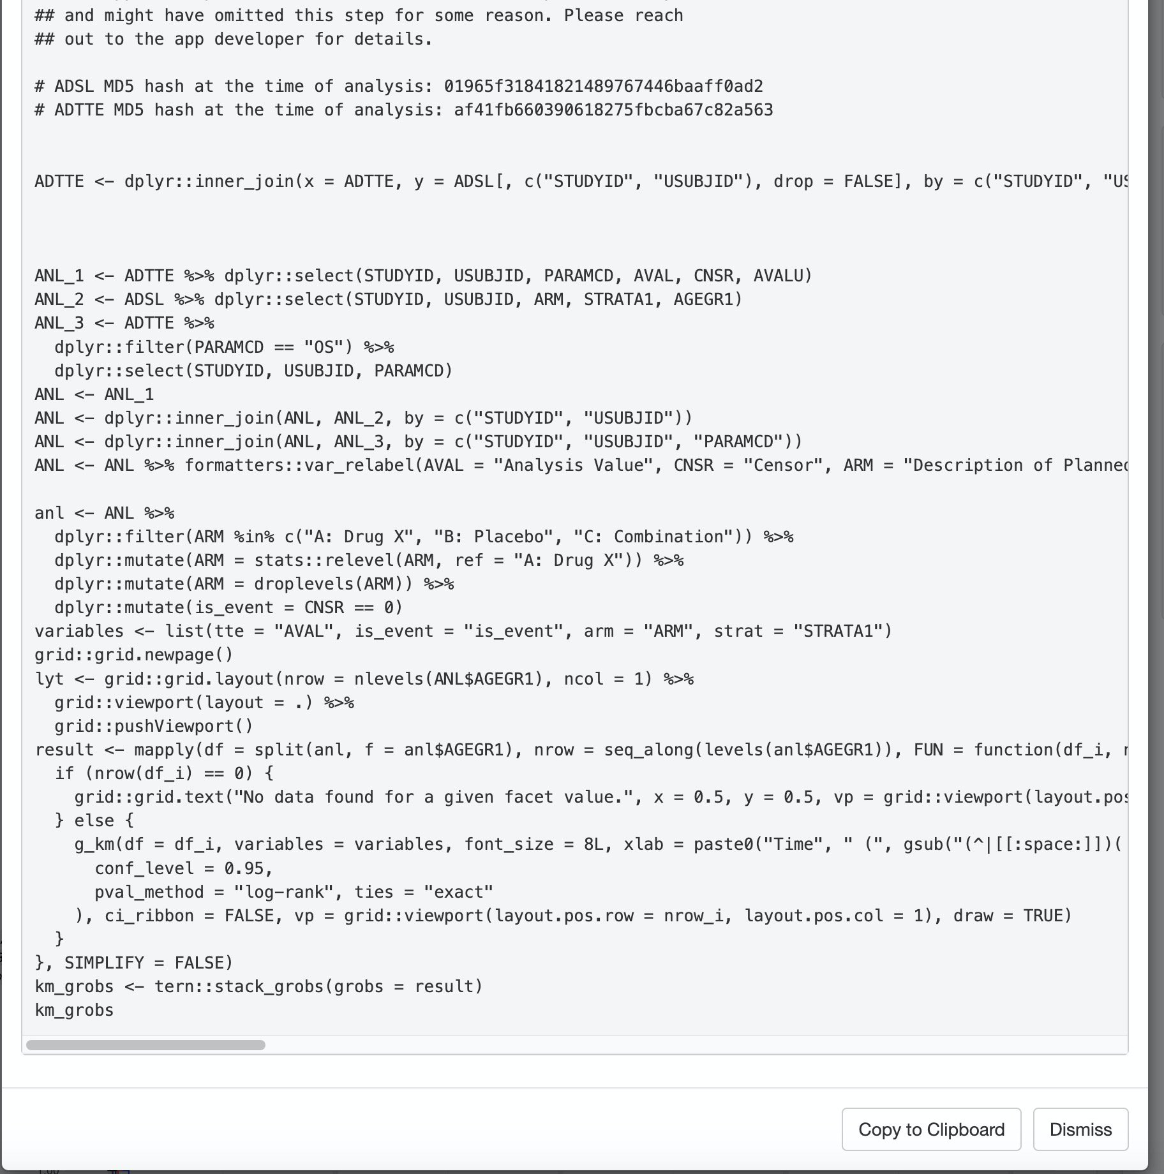
Key Features: Show R Code
Reproducible code when you see the desired output in analysis
Include any filters added
Include library ( ) calls

Slide 18
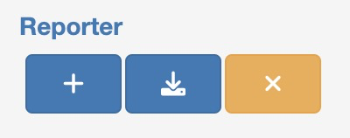
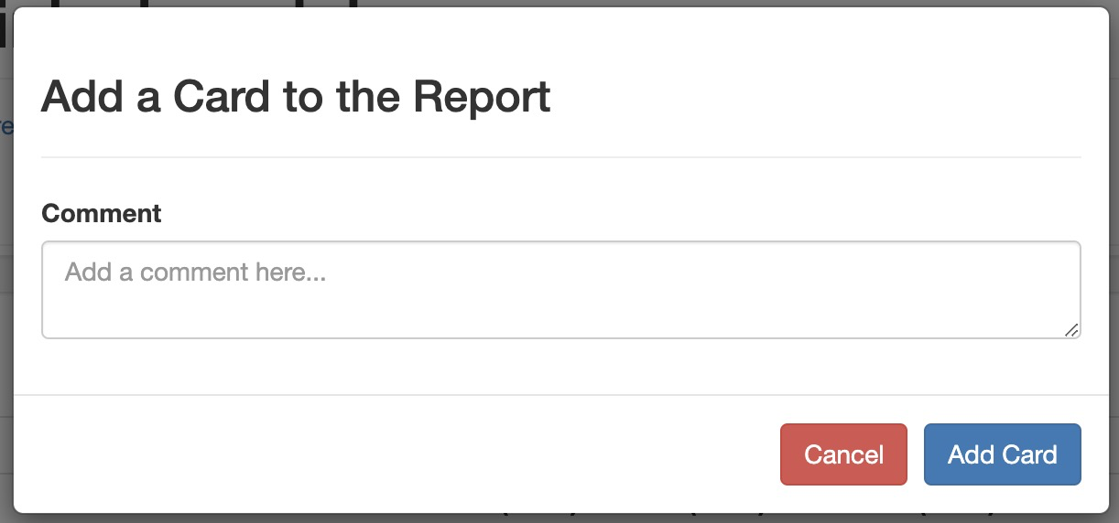
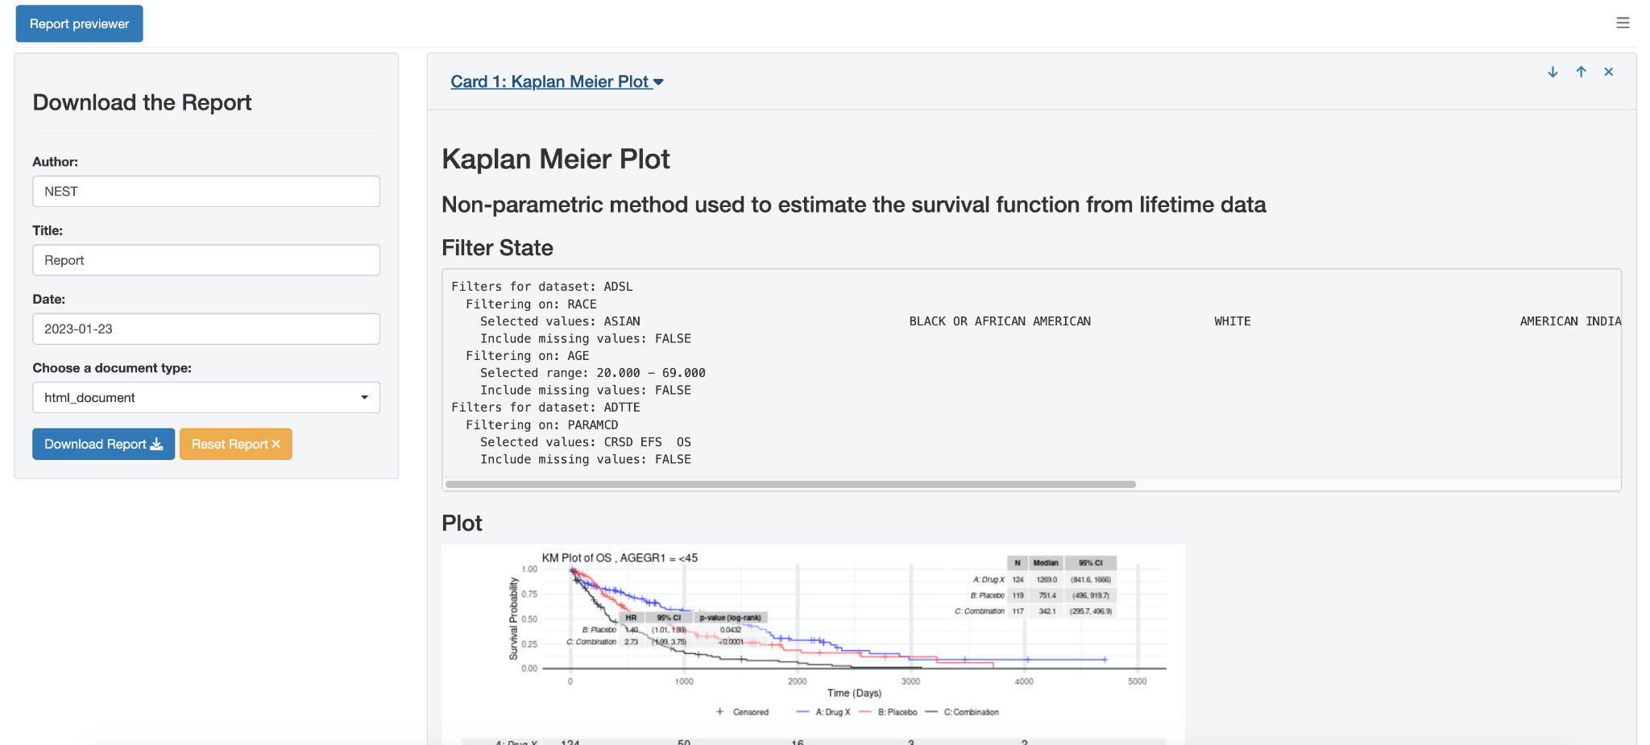
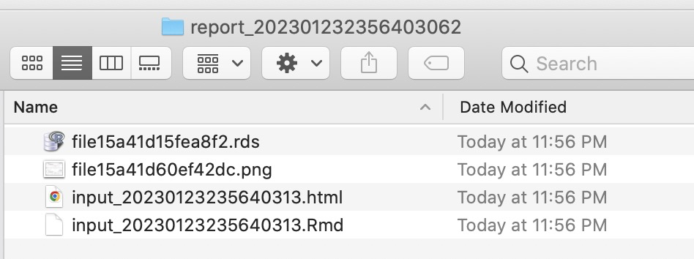
Key Features: teal Reporter
Create a report for your analysis
Zip file that contains:
.Rmd
.rds
.png
And the requested report type
(html, pdf, or ppt)

Slide 19
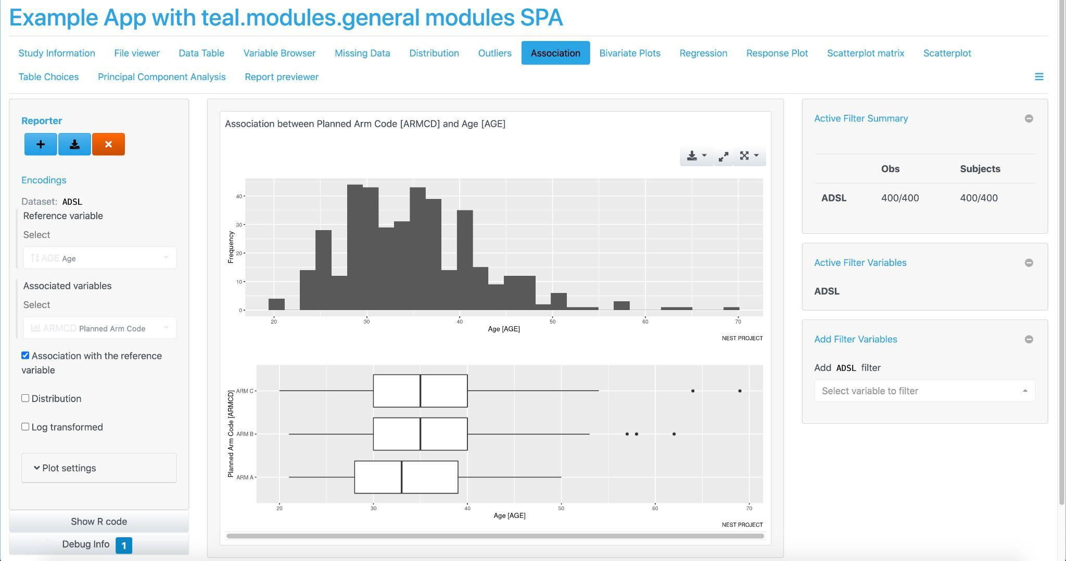
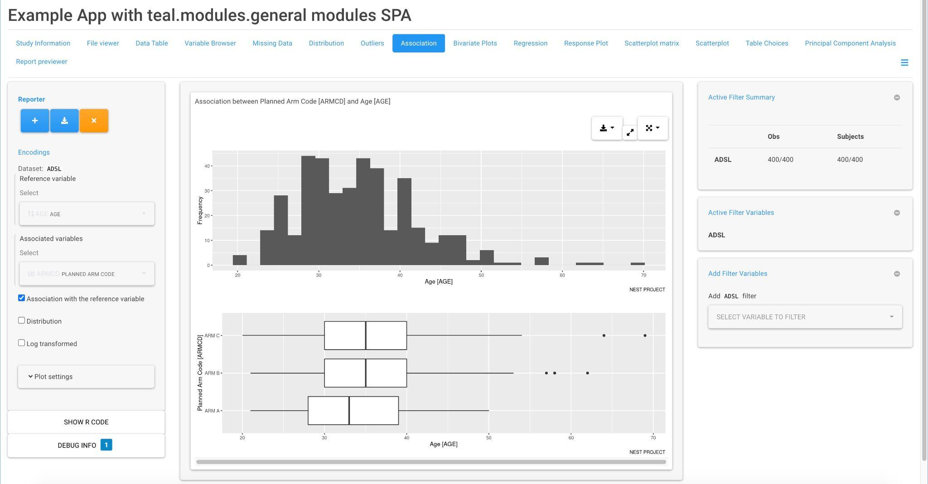
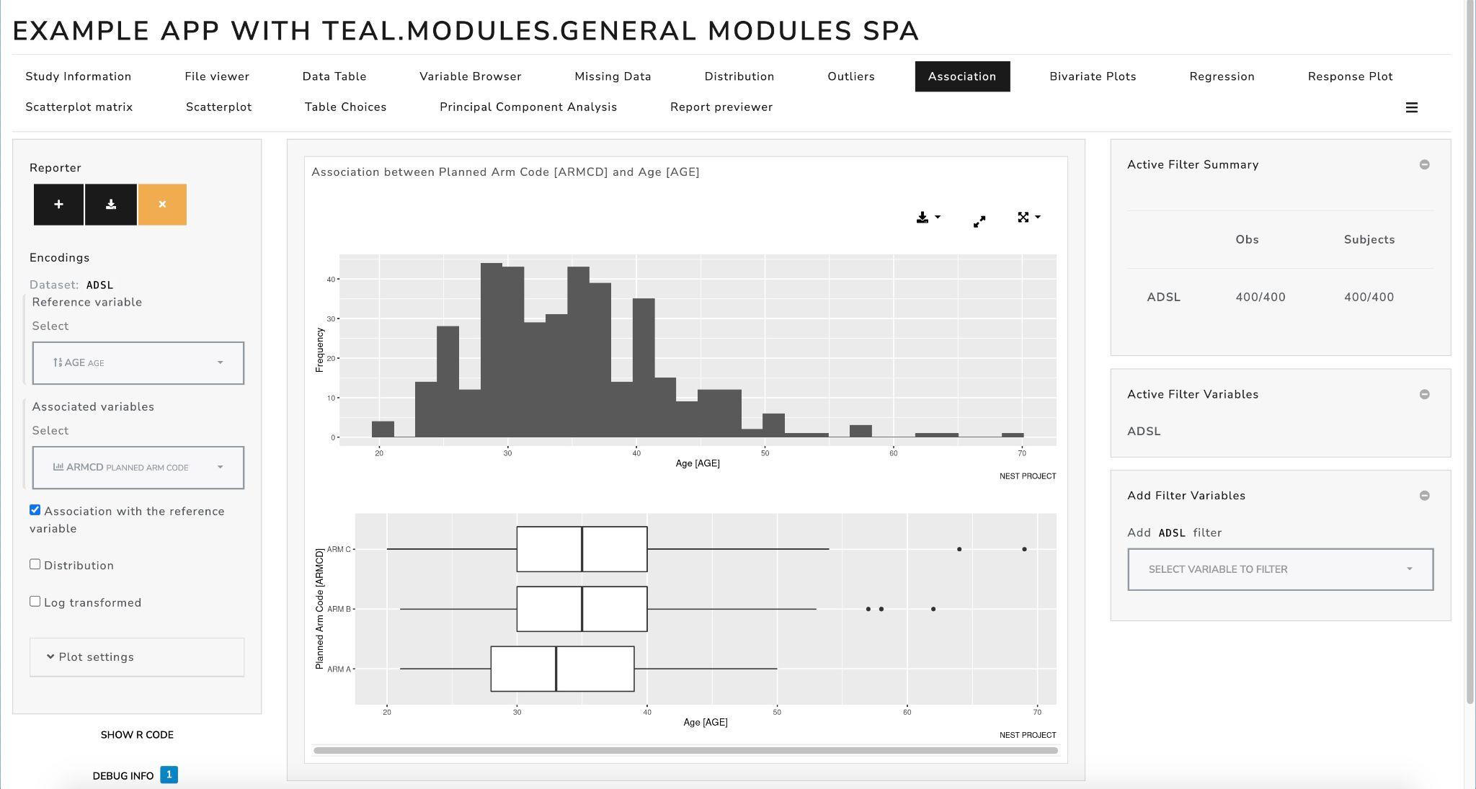
Key Features: teal bootstrap theme
Customize the look of your teal app, powered by bslib
Custom and real-live theming
https://insightsengineering.github.io/teal/latest-tag/articles/teal-bs-themes.html

Slide 20
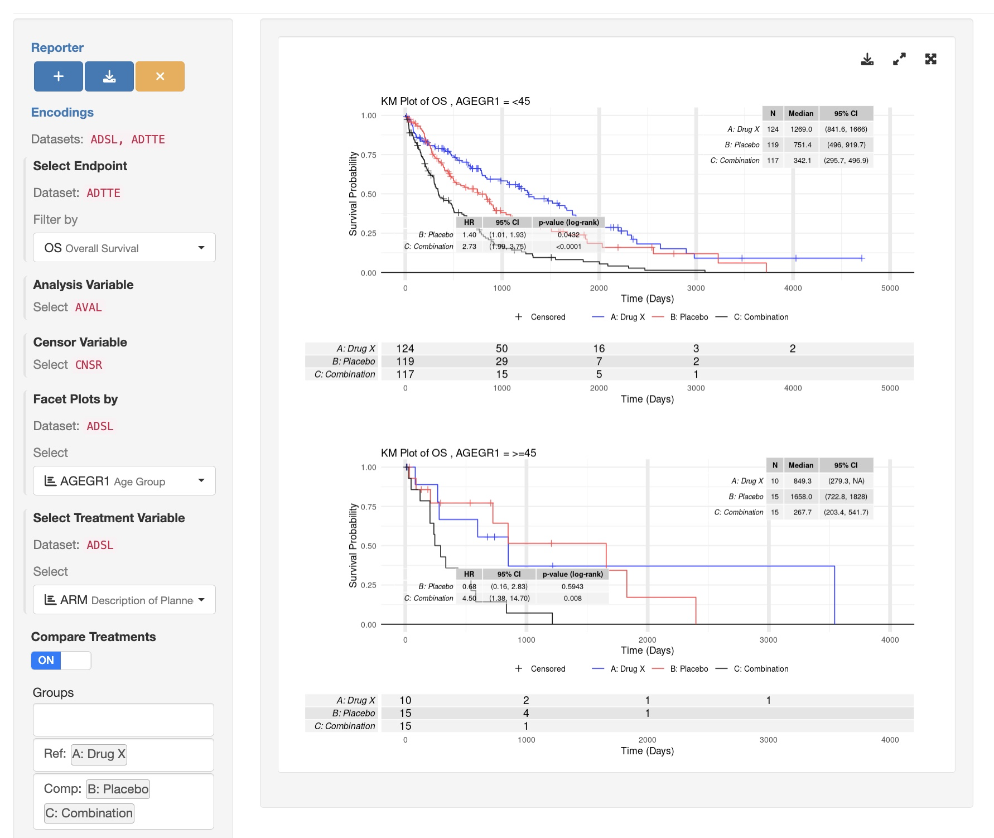
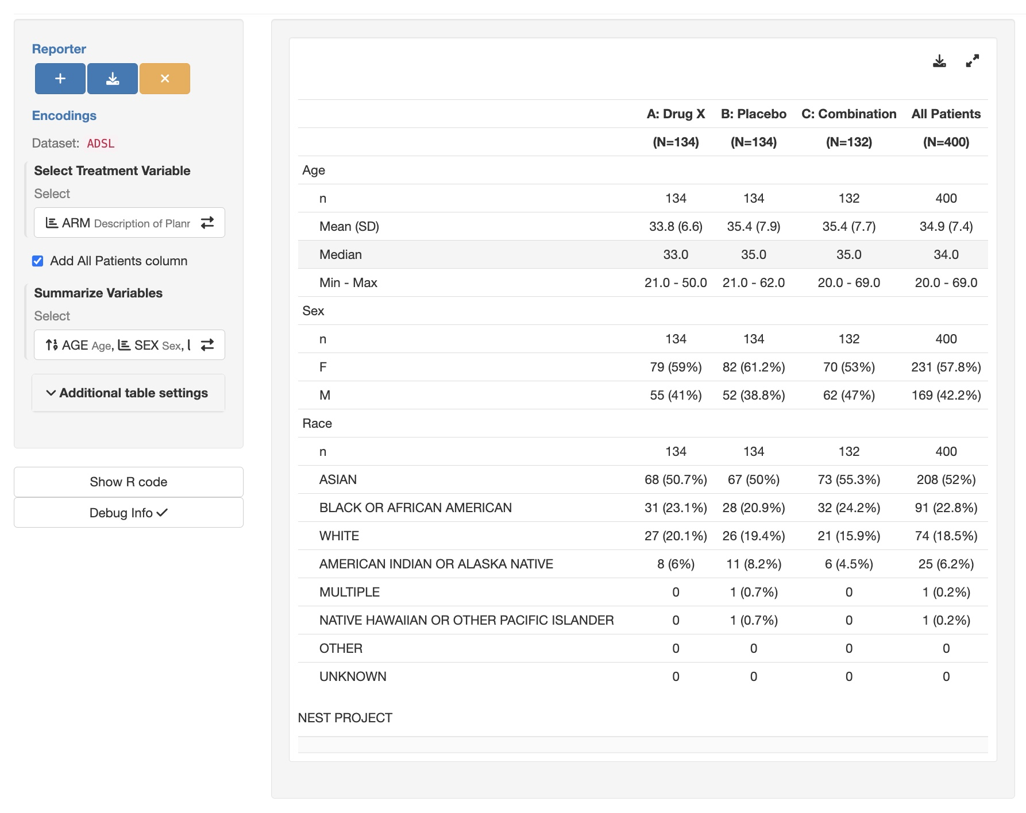
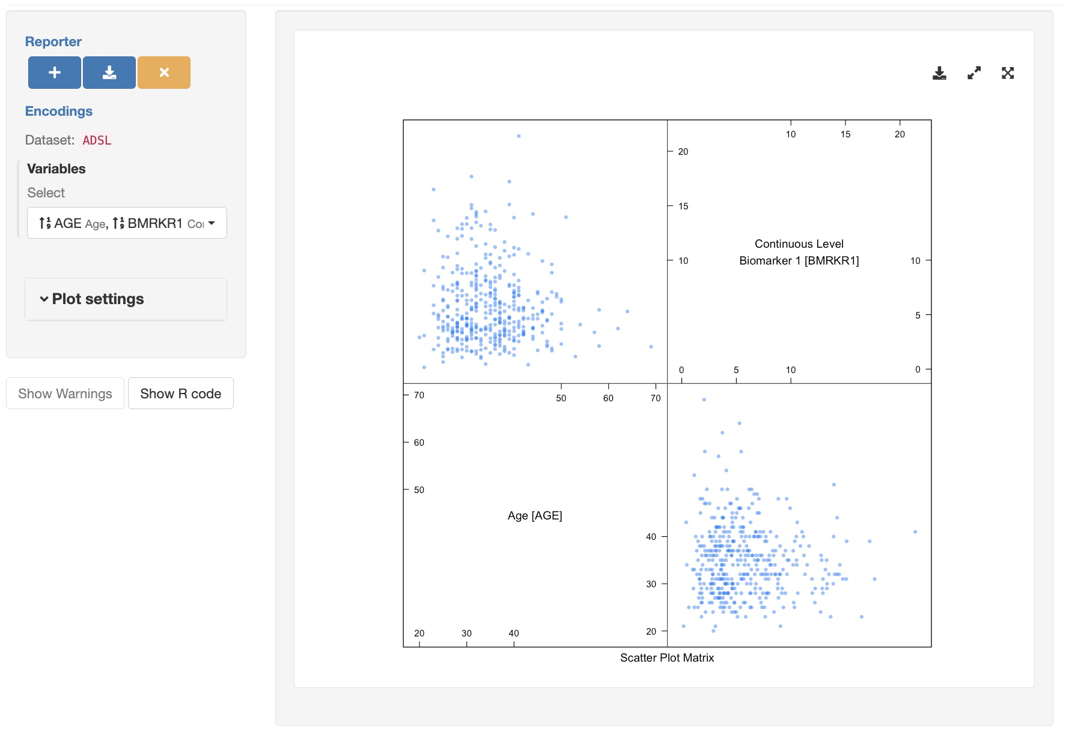
Key Features: Curated sets of teal modules for targeted purposes
Actively developed and maintained centrally by a dedicated team
Purposefully designed, e.g. for clinical trials reporting or biomarker analysis
50+ common analysis modules available for use

Slide 21

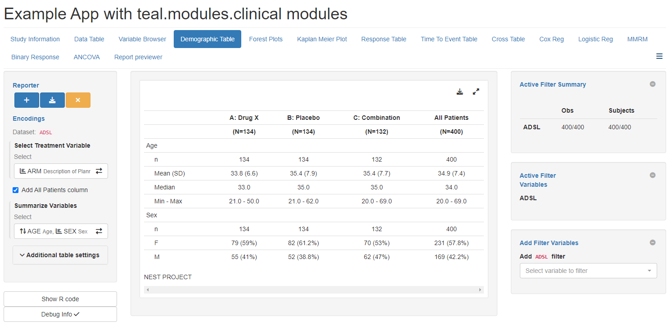

{teal} Universe Products Map
teal framework (core)
teal modules
Calculations
teal
teal.modules.general
teal.modules.clinical
tern
teal.slice
teal.reporter
teal.widgets
teal.osprey
osprey
teal.logger
teal.data
teal.transform
teal.goshawk
goshawk
teal.code
teal.modules.hermes
hermes

Slide 22


teal Framework R Packages
teal Modules R Packages
teal: shiny-based interactive exploration framework
for analyzing data
teal.modules.general: general analysis modules for exploring any data types
teal.widgets: shiny components used within teal
teal.modules.clinical: modules for analyzing CDISC data and clinical trial reporting with tern R package
teal.reporter: allows teal applications to generate reports
teal.slice: provides a filtering panel to allow subset of data
teal.osprey: modules for analyzing and reporting early-phase clinical trial data with osprey R package
teal.data: creating and loading the data needed
for teal applications
teal.goshawk: modules for analyzing and visualizing biomarker data with goshawk R package
teal.code: handles reproducibility of outputs
teal.modules.hermes: modules for analyzing and visualizing RNAseq data with hermes R package
teal.transform: standardizes extracting and merging data
teal.logger: standardizes logging within teal framework

Slide 23
Exercise!
The agenda:
01-hello-world.R
02-data.R
03-encoding-panel.R
04-reproducibility.R
05_report.R
06-teal-modules.R
07-01-ard.R
07-02-ard-encoding.R
07-03-ard-all.R
Let's do them together
Please do it yourself 🚀
⚠ Scroll down the script to see the answers🫣

Slide 24

{teal} Playground
Posit Cloud Link:
https://posit.cloud/spaces/340990/join?access_code=M52ibtFP2ASLLL1MItA-dThXpPzJvRqnxdNOgejA
Public Docker Image:
https://github.com/insightsengineering/ci-images/pkgs/container/rstudio_4.3.1_bioc_3.17

Slide 25

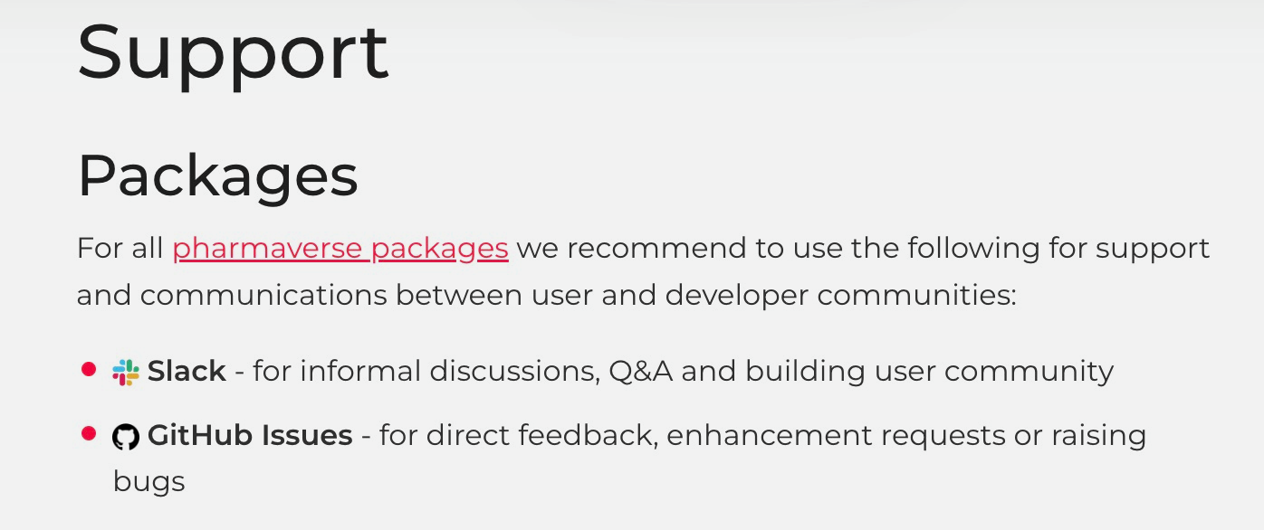

Additional Resources
{teal} is part of pharmaverse: https://pharmaverse.org/
More information about support: https://pharmaverse.org/support/
Slack channel #teal under pharmaverse workspace
Upcoming course on Coursera “Hands On Clinical Reporting Using R” in Q4 2023

Slide 26





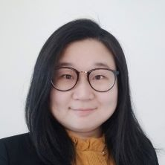
Collaborating on {teal}
We are looking for collaborators to develop this framework further!
If you’re an individual, please contribute on GitHub and join us via pharmaverse Slack #teal channel
If you’re an organization wanting to adopt {teal}
and co-develop, please get in touch with our Product Owner chendi.liao@roche.com

Slide 27




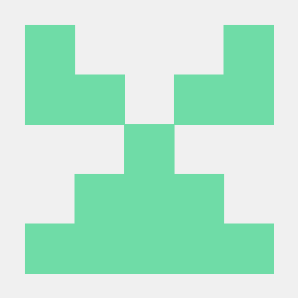



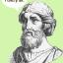



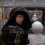




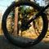


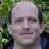
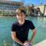




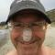

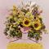
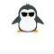
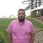
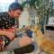




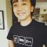
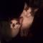

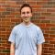
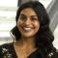

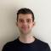




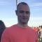
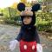


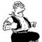

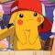


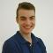

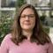
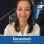








Acknowledgement
and many more …

